Slide 1
Investigation of crime data in Russia (2003-2020)
By: Evan Edmunds
Dsc 530

Slide 2
Variables of interest
month: The month crime data was collected
Total_crimes: total number of crimes in a time period
The rest of the variables are counts of specific crimes that were reported in a given month
Serious
Huge_damage
Ecological
Terrorism
Extremism
Murder
Harm_to_health
Rape
Theft
Vehicle_theft
Fraud_scam
Hooligan
Drugs
Weapons

Slide 3


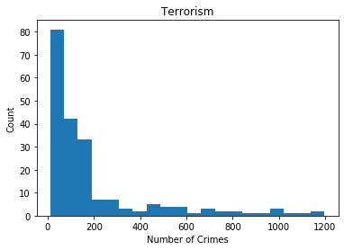
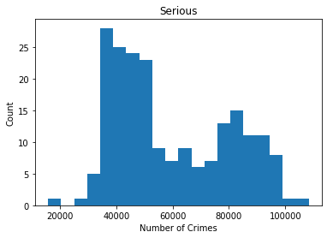
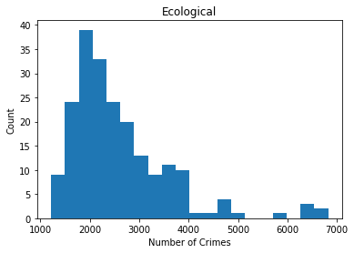
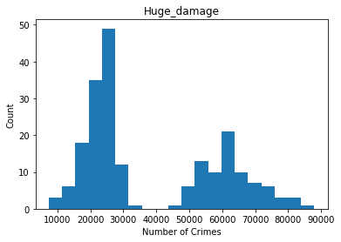
histograms
Looking at the plots, it seems that there are some outliers in the data:
In the Ecological variable, the right three bins with values.

Slide 4
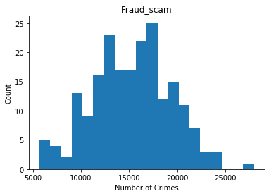
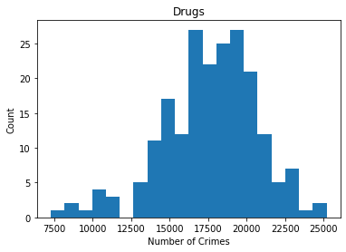
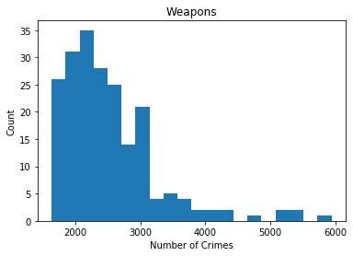
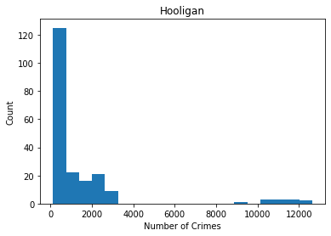
histograms
Looking at the plots, it seems that there are some outliers in the data:
In the Fraud_scam variable, the far right value
For the Weapons and Drugs plots, I’m inclined to say that the smaller count bins on the extreme edges are more likely to be tails, than outliers.

Slide 5
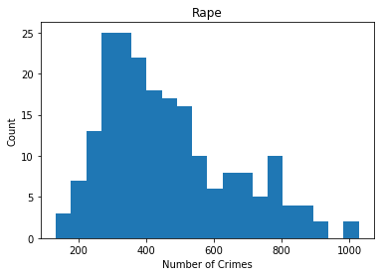
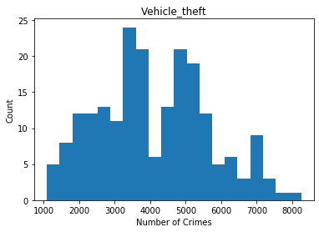
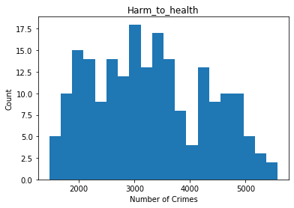
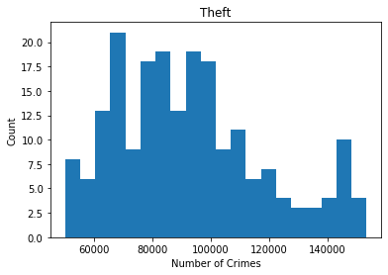
histograms
Looking at the plots, I can say that it looks like there are no outliers in the plots, and the values furthest from the modes are the tails of the distribution, not outliers.

Slide 6
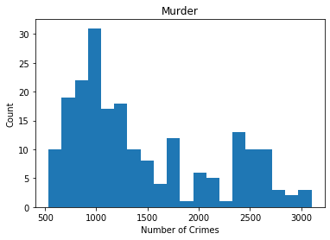
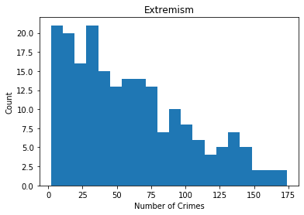
histograms
Looking at the plots, I can say that it looks like there are no outliers in the plots, and the values furthest from the modes are the tails of the distribution, not outliers.
Since all of these variables represent counts of real life crime rates, I’m going to leave all data in, even though there do seem to be some outliers present. Since I am doing all my correlation analyses using the spearman method, I’m not concerned with outliers inhibiting that part of my hypothesis testing. I also don’t think the outliers are far enough from the mode to have a significant impact on the regression analysis.

Slide 7
Summary stats of all variables
Serious Crime Stats: mean = 59068.49, mode = 65170.00, spread = 418261854.34, tails = -1.09.
Huge_damage Crime Stats: mean = 38402.04, mode = 87941.00, spread = 428680561.49, tails = -1.22.
Ecological Crime Stats: mean = 2592.46, mode = 2308.00, spread = 1051836.74, tails = 3.94.
Terrorism Crime Stats: mean = 197.84, mode = 63.00, spread = 59958.00, tails = 4.63.
Extremism Crime Stats: mean = 59.47, mode = 35.00, spread = 1761.29, tails = -0.37.
Murder Crime Stats: mean = 1451.40, mode = 1287.00, spread = 470643.19, tails = -0.76.
Harm_to_health Crime Stats: mean = 3276.02, mode = 5021.00, spread = 1022901.57, tails = -0.90.
Rape Crime Stats: mean = 463.58, mode = 515.00, spread = 35326.43, tails = -0.10.
Theft Crime Stats: mean = 92647.56, mode = 153394.00, spread = 640817694.90, tails = -0.25.
Vehicle_theft Crime Stats: mean = 4101.41, mode = 7047.00, spread = 2439404.54, tails = -0.59.
Fraud_scam Crime Stats: mean = 15277.83, mode = 16912.00, spread = 16846321.88, tails = -0.22.
Hooligan Crime Stats: mean = 1457.65, mode = 194.00, spread = 6526162.47, tails = 10.17.
Drugs Crime Stats: mean = 17644.36, mode = 20176.00, spread = 9367464.14, tails = 0.84.
Weapons Crime Stats: mean = 2525.02, mode = 2089.00, spread = 534915.95, tails = 4.79.

Slide 8
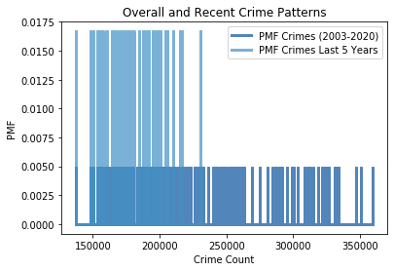
Crime patterns overall against recent
Created using the Total_crimes variables.
The plot shows values are more tightly packed than the overall data and gives the impression of a lesser crime rate than the full time length data.

Slide 9
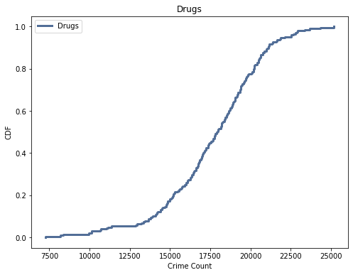
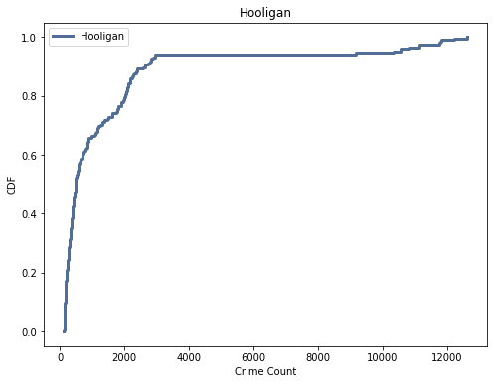
Cdf analysis
A CDF of the Drugs and Hooligan variables
The Drugs CDF bears a somewhat sigmoidal shape, indictating a normal distribution, while the Hooligan CDF lacks this pattern and more resembles a Pareto distribution.
Illustrates that there is a variance in the normality between different categories of crime. Therefore, linear regression may not be the best predictor for all variables.

Slide 10
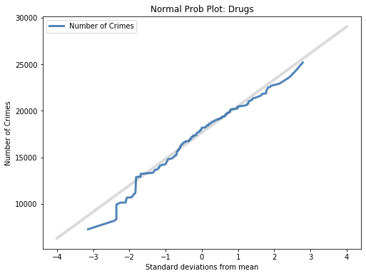
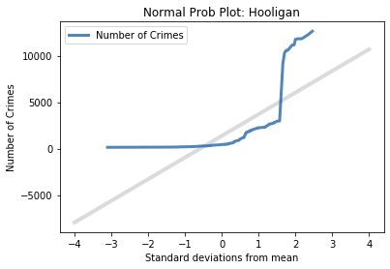
Analytic distribution
A further investigation of the CDFs of the Hooligan and Drugs variables
These normal probability plots confirm that Hooligan is not normally distributed.
It also provides more insight into Drugs, showing that while it is normal to about 1.5 standard deviations from the mean, the tails veer drastically from normally greater than 1.5 standard deviations.

Slide 11
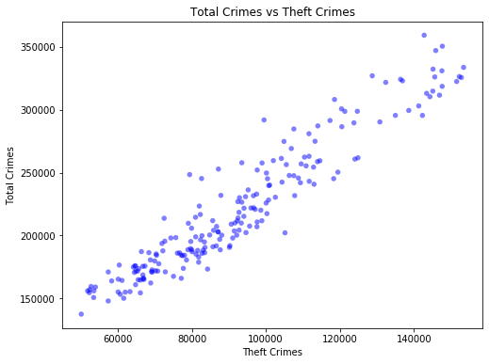
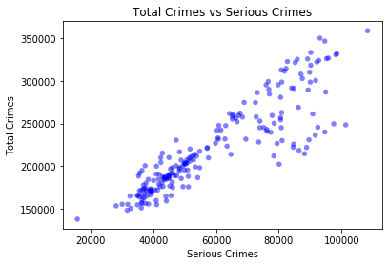
Scatterplots
Serious crime stats
Spearman's correlation: 0.91
Covariance: 938,357,713.01
Theft crime stats
Spearman's correlation: 0.95
Covariance: 1,240,667,861.83
Both of these plots show a possible strong correlation with the Total_crimes variable. The correlation value supports this, as does the covariance value (may be due to large values).
Either variable should be a good predictor for total crimes.

Slide 12
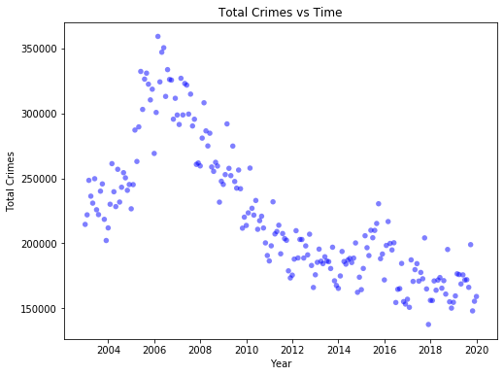
Additional Scatterplot
This plot shows that the greatest count of crimes happened around 2006 and has decreased since then.
This answers my question of whether total crime counts have changed over time.

Slide 13
Hypothesis Testing
It was my hypothesis that there would be strong correlations between crime of different categories. To test this, I calculated the correlation between Serious and Theft using the Spearman method since I have now seen that they are both correlated with Total_crimes. Then I used the CorrelationPermute function on pg. 125 of ThinkStats to calculate the p-value. The results are below:
Spearman Correlation - 0.83
P-value – 0.0

Slide 14
Linear Regression models
Theft regression analysis
Intercept 4.19e+04 (1.07e-18)
Theft 1.94 (1.68e-104)
R^2 0.9023
Std(ys) 5.159e+04
Std(res) 1.616e+04
Serious regression analysis
Intercept 8.88e+04 (1.62e-42)
Serious 2.24 (6.75e-71)
R^2 0.7908
Std(ys) 5.159e+04
Std(res) 2.365e+04
Two simple regression models were created, Theft predicting Total_crimes and Serious predicting Total_crimes. These two were chosen based on their high correlation with the Total_crimes variable. R-squared values suggest that the Total_crimes vs Theft model is better, as it explains 90.23% of variance between the two variables.

